Slide 1
Chapter 11:
Artificial Intelligence
Computer Science: An Overview
Eleventh Edition
by
J. Glenn Brookshear

Slide 2
Chapter 11: Artificial Intelligence
11.1 Intelligence and Machines
11.2 Perception
11.3 Reasoning
11.4 Additional Areas of Research
11.5 Artificial Neural Networks
11.6 Robotics
11.7 Considering the Consequences
0-<number>

Slide 3
Intelligent Agents
Agent: A “device” that responds to stimuli from its environment
  Sensors
  Actuators
Much of the research in artificial intelligence can be viewed in the context of building agents that behave intelligently
0-<number>

Slide 4
Levels of Intelligent Behavior
Reflex: actions are predetermined responses to the input data
More intelligent behavior requires knowledge of the environment and involves such activities as:
  Goal seeking
  Learning
0-<number>

Slide 5
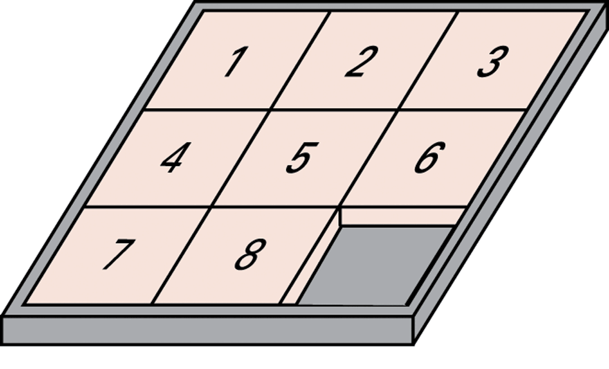
Figure 11.1 The eight-puzzle in its solved configuration
0-<number>

Slide 6
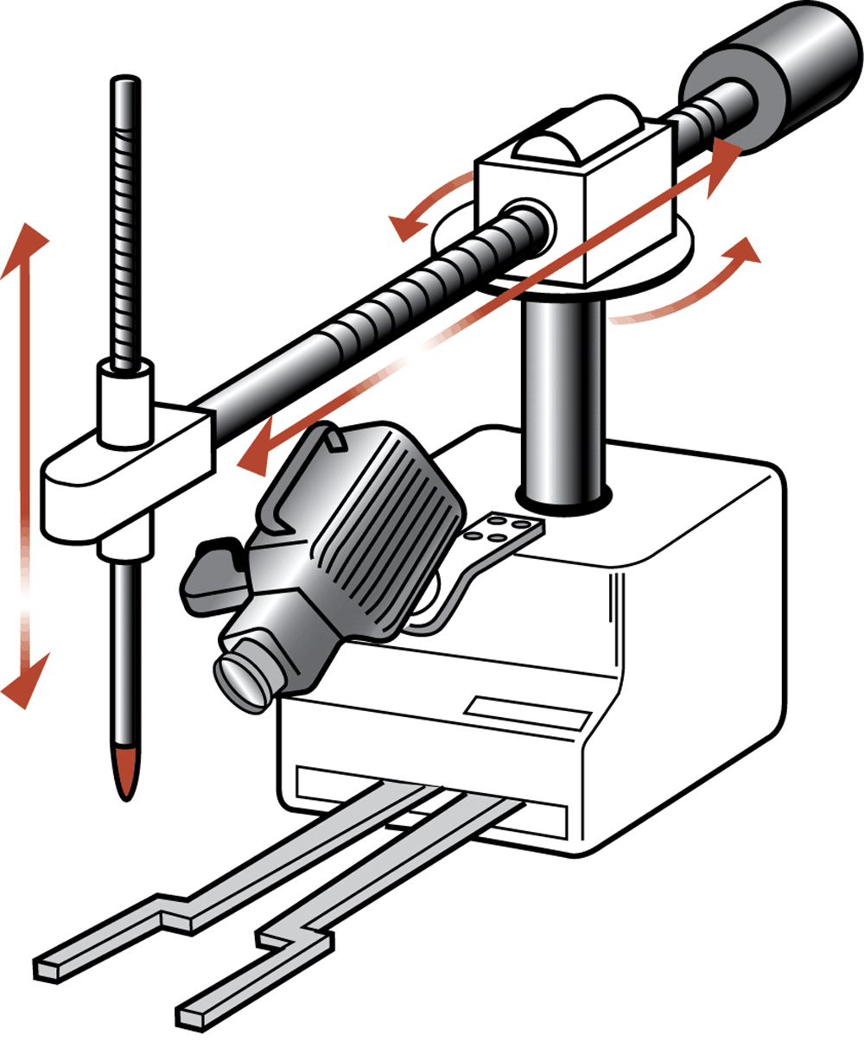
Figure 11.2 Our puzzle-solving machine
0-<number>

Slide 7
Approaches to Research in Artificial Intelligence
Engineering track
  Performance oriented
Theoretical track
  Simulation oriented
0-<number>

Slide 8
Turing Test
Test setup: Human interrogator communicates with test subject by typewriter.
Test: Can the human interrogator distinguish whether the test subject is human or machine?
0-<number>

Slide 9
Techniques for Understanding Images
Template matching
Image processing
  edge enhancement
  region finding
  smoothing
Image analysis
0-<number>

Slide 10
Language Processing
Syntactic Analysis
Semantic Analysis
Contextual Analysis
0-<number>

Slide 11
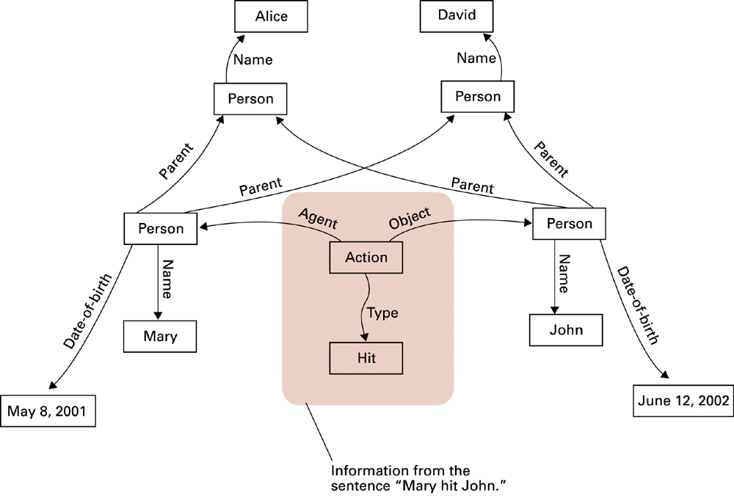
Figure 11.3 A semantic net
0-<number>

Slide 12
Components of a Production Systems
1. Collection of states
  Start (or initial) state
  Goal state (or states)
2. Collection of productions: rules or moves
  Each production may have preconditions
3. Control system: decides which production to apply next
0-<number>

Slide 13
Reasoning by Searching
State Graph: All states and productions
Search Tree: A record of state transitions explored while searching for a goal state
  Breadth-first search
  Depth-first search
0-<number>

Slide 14
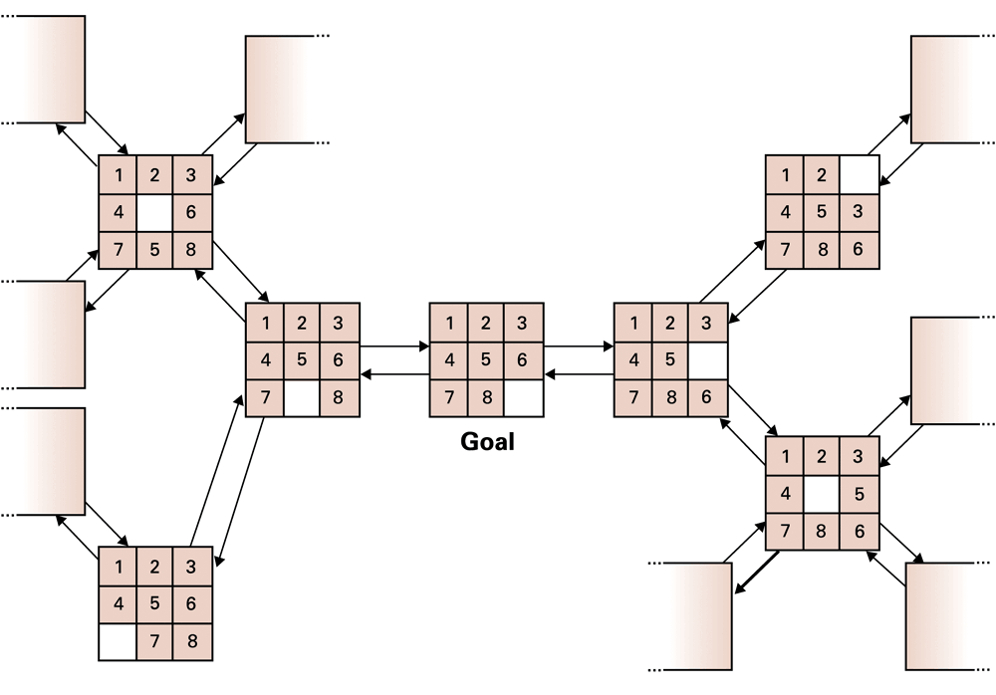
Figure 11.4 A small portion of the eight-puzzle’s state graph
0-<number>

Slide 15
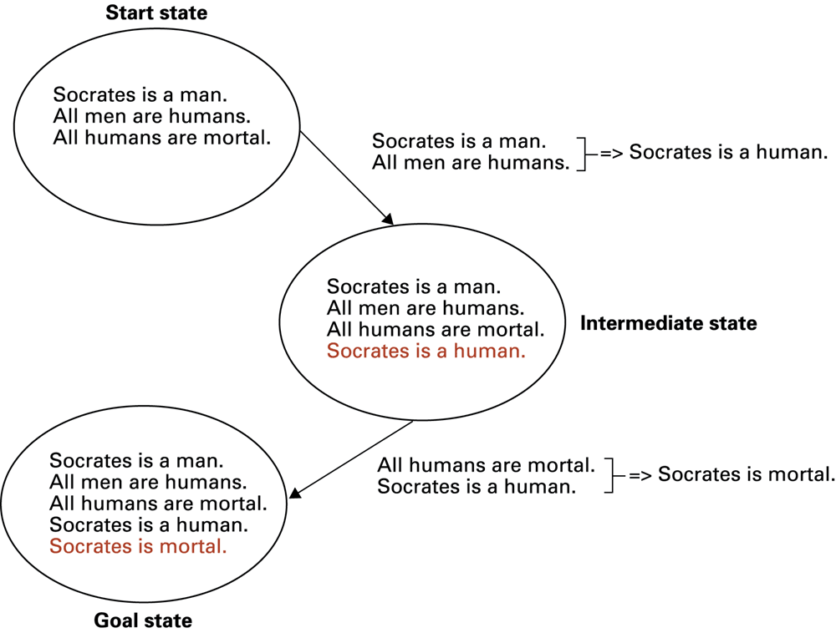
Figure 11.5 Deductive reasoning in the context of a production system
0-<number>

Slide 16
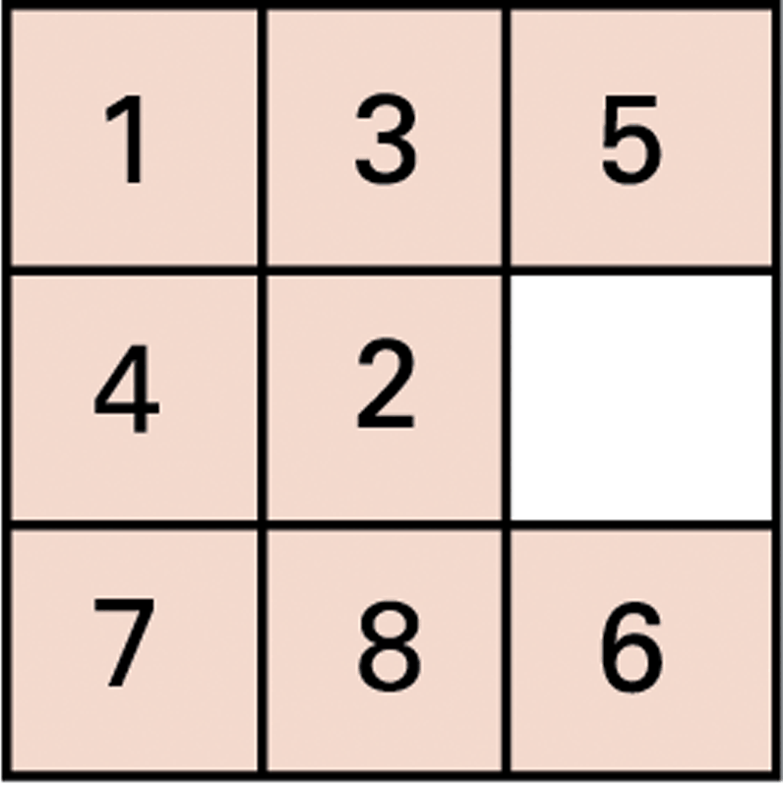
Figure 11.6 An unsolved eight-puzzle
0-<number>

Slide 17
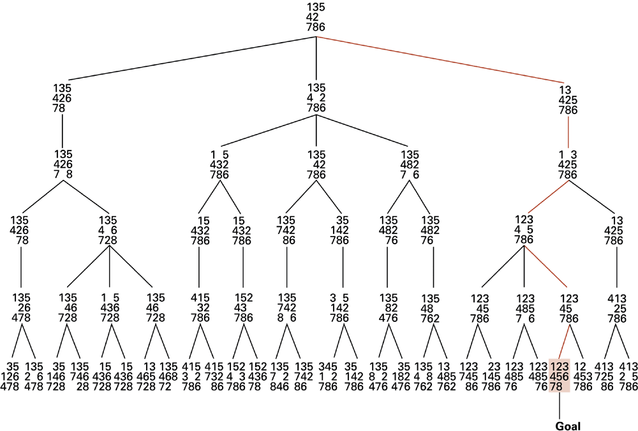
Figure 11.7 A sample search tree
0-<number>

Slide 18
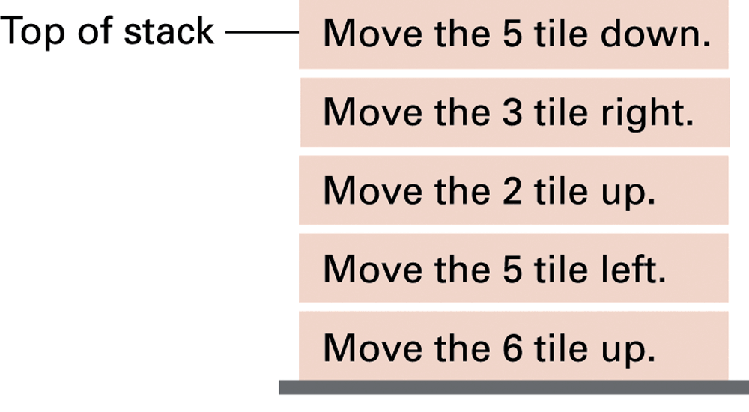
Figure 11.8 Productions stacked for later execution
0-<number>

Slide 19
Heuristic Strategies
Heuristic: A “rule of thumb” for making decisions
Requirements for good heuristics
  Must be easier to compute than a complete solution
  Must provide a reasonable estimate of proximity to a goal
0-<number>

Slide 20
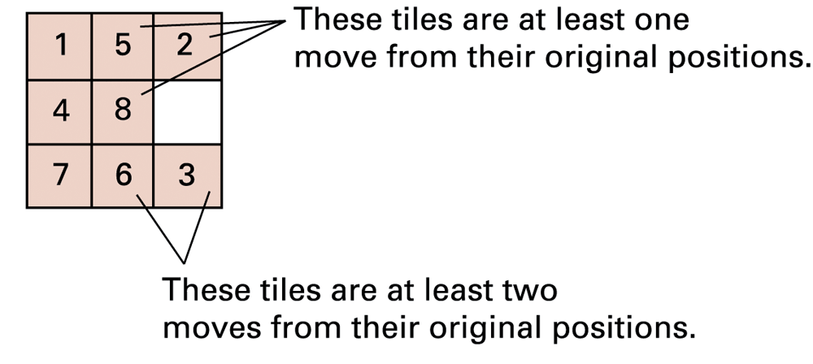
Figure 11.9 An unsolved eight-puzzle
0-<number>

Slide 21
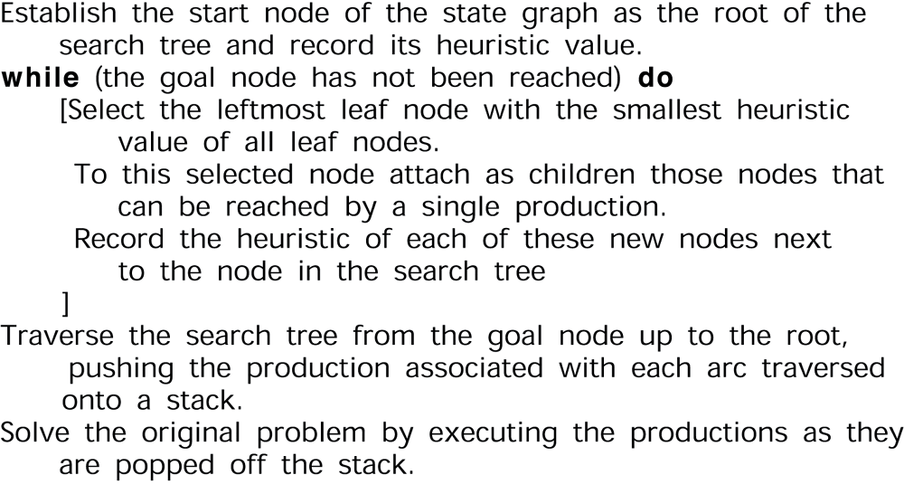
Figure 11.10 An algorithm for a control system using heuristics
0-<number>

Slide 22
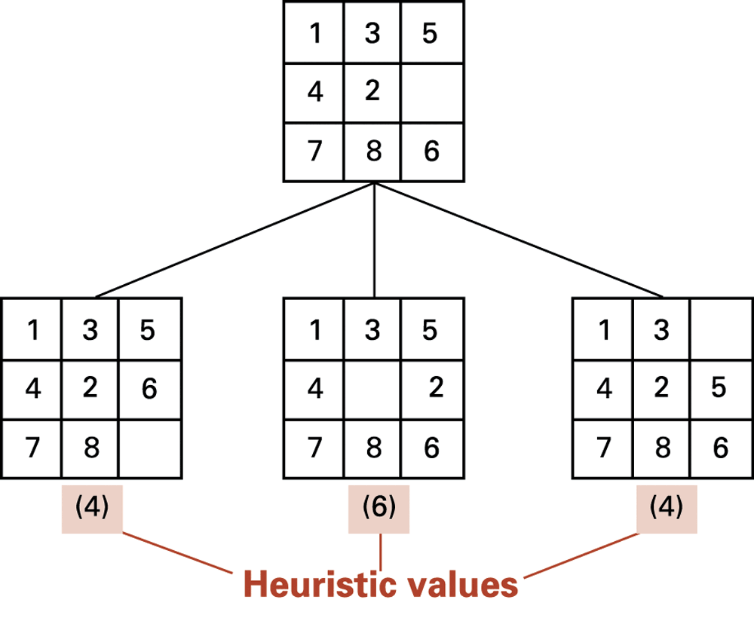
Figure 11.11 The beginnings of our heuristic search
0-<number>

Slide 23
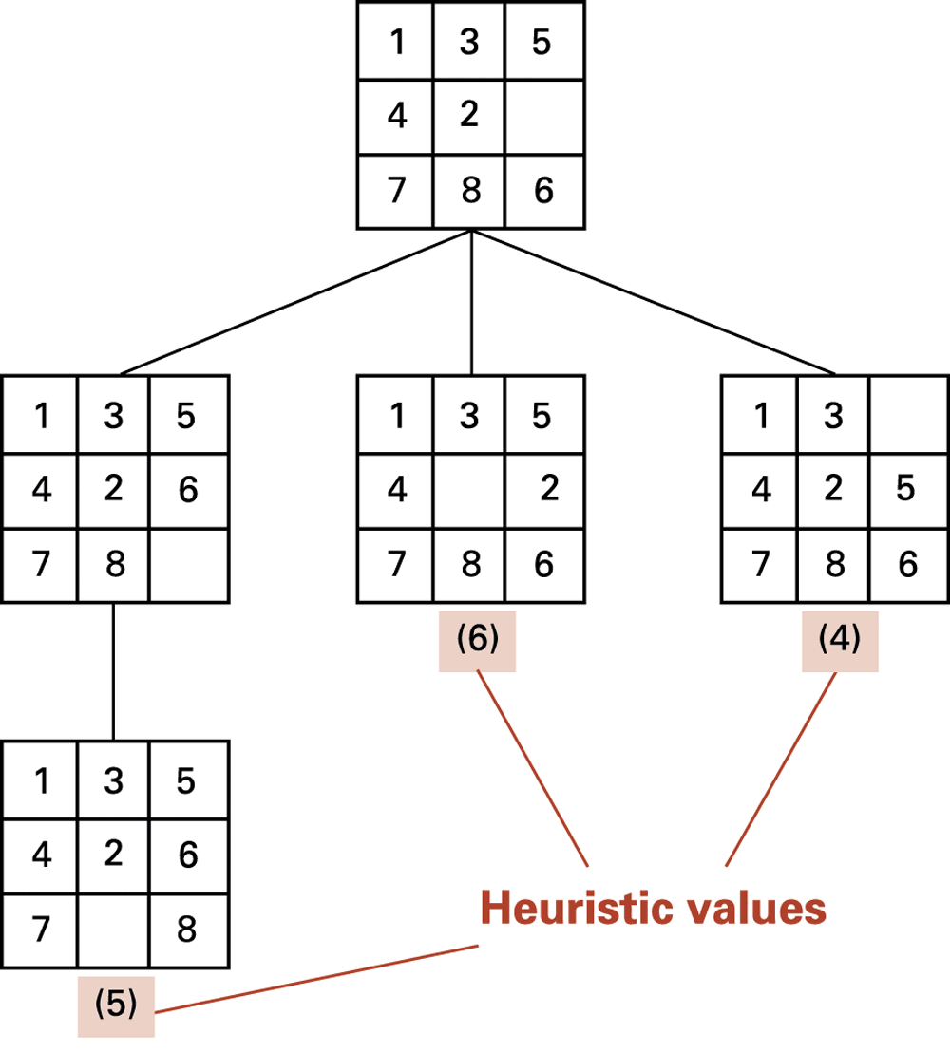
Figure 11.12 The search tree after two passes
0-<number>

Slide 24
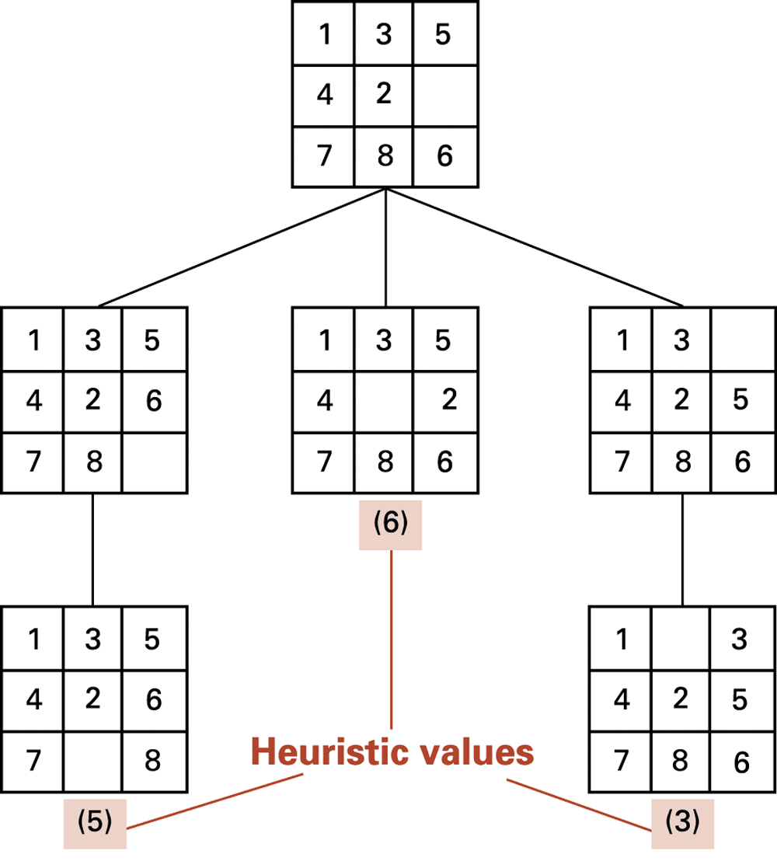
Figure 11.13 The search tree after three passes
0-<number>

Slide 25
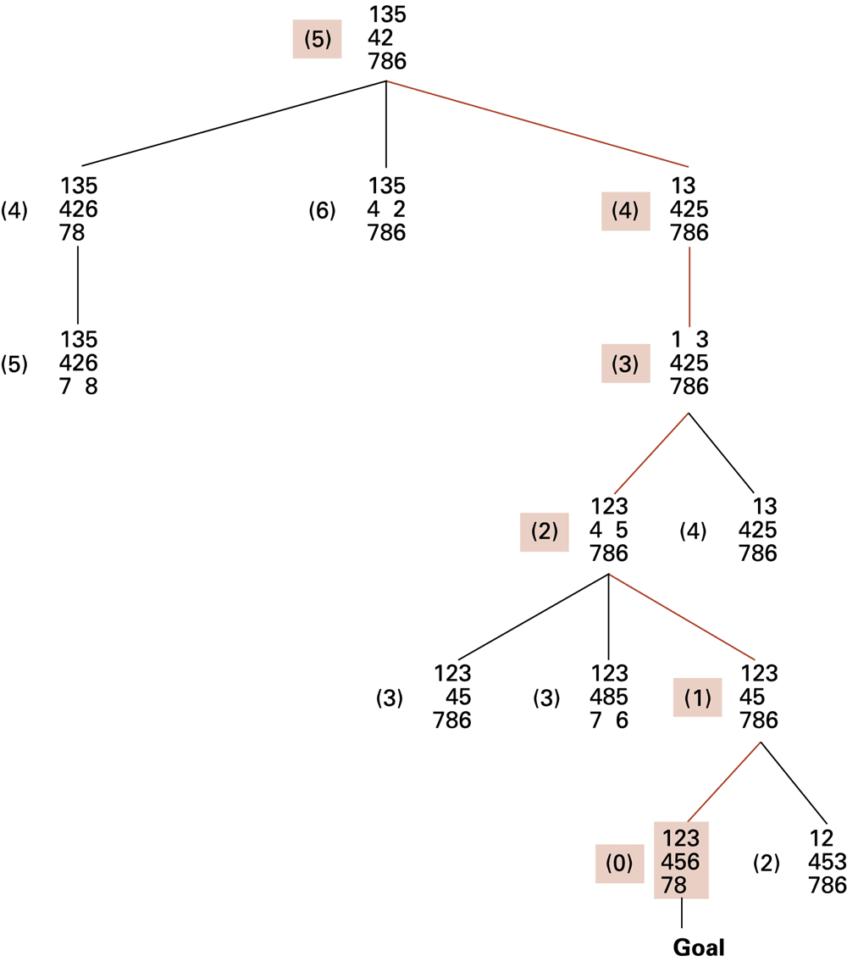
Figure 11.14 The complete search tree formed by our heuristic system
0-<number>

Slide 26
Handling Real-World Knowledge
Representation and storage
Accessing relevant information
  Meta-Reasoning
  Closed-World Assumption
Frame problem
0-<number>

Slide 27
Learning
Imitation
Supervised Training
  Training Set
Reinforcement
0-<number>

Slide 28
Genetic Algorithms
Begins by generating a random pool of trial solutions:
  Each solution is a chromosome
  Each component of a chromosome is a gene
Repeatedly generate new pools
  Each new chromosome is an offspring of two parents from the previous pool
  Probabilistic preference used to select parents
  Each offspring is a combination of the parent’s genes
0-<number>

Slide 29
Artificial Neural Networks
Artificial Neuron
  Each input is multiplied by a weighting factor.
  Output is 1 if sum of weighted inputs exceeds the threshold value; 0 otherwise.
Network is programmed by adjusting weights using feedback from examples.
0-<number>

Slide 30
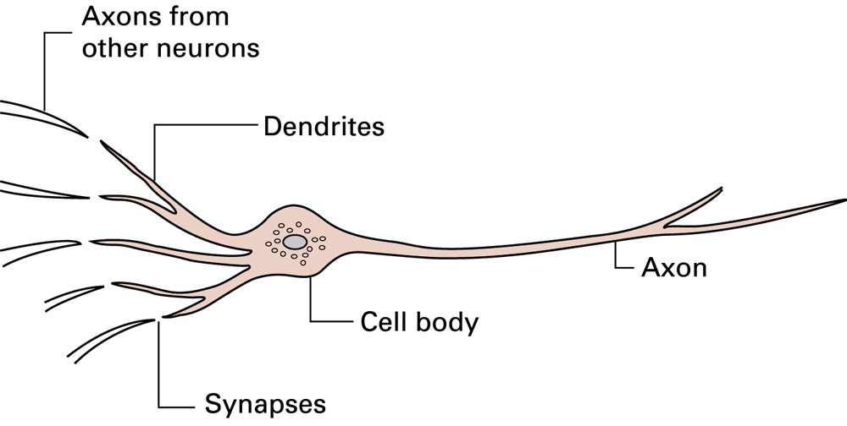
Figure 11.15 A neuron in a living biological system
0-<number>

Slide 31
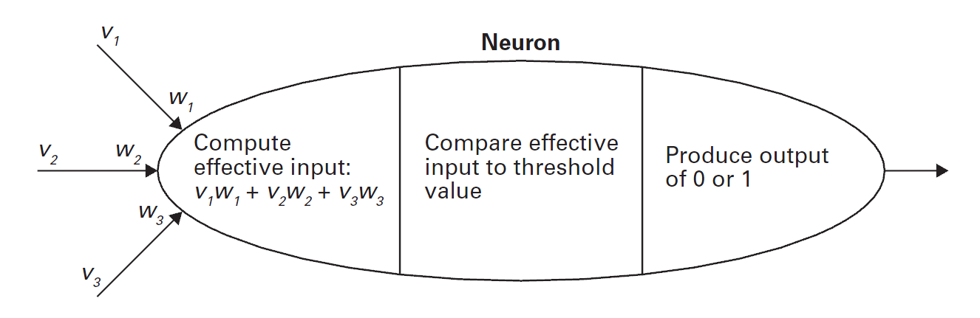
Figure 11.16 The activities within a processing unit
0-<number>

Slide 32
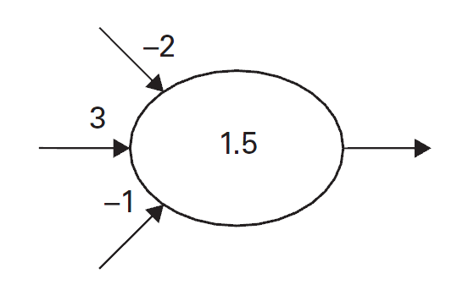
Figure 11.17 Representation of a processing unit
0-<number>

Slide 33
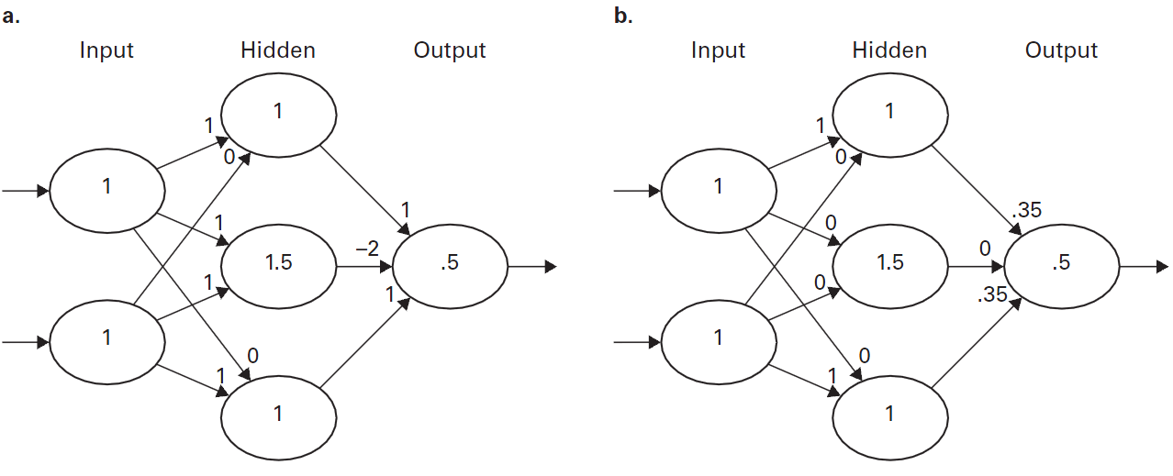
Figure 11.18 A neural network with two different programs
0-<number>

Slide 34
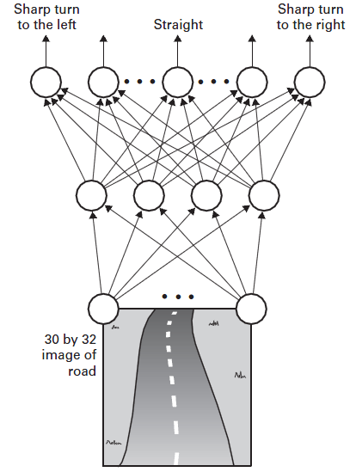
Figure 11.20 The structure of ALVINN
0-<number>

Slide 35
Associative Memory
Associative memory: The retrieval of information relevant to the information at hand
One direction of research seeks to build associative memory using neural networks that when given a partial pattern, transition themselves to a completed pattern.
0-<number>

Slide 36
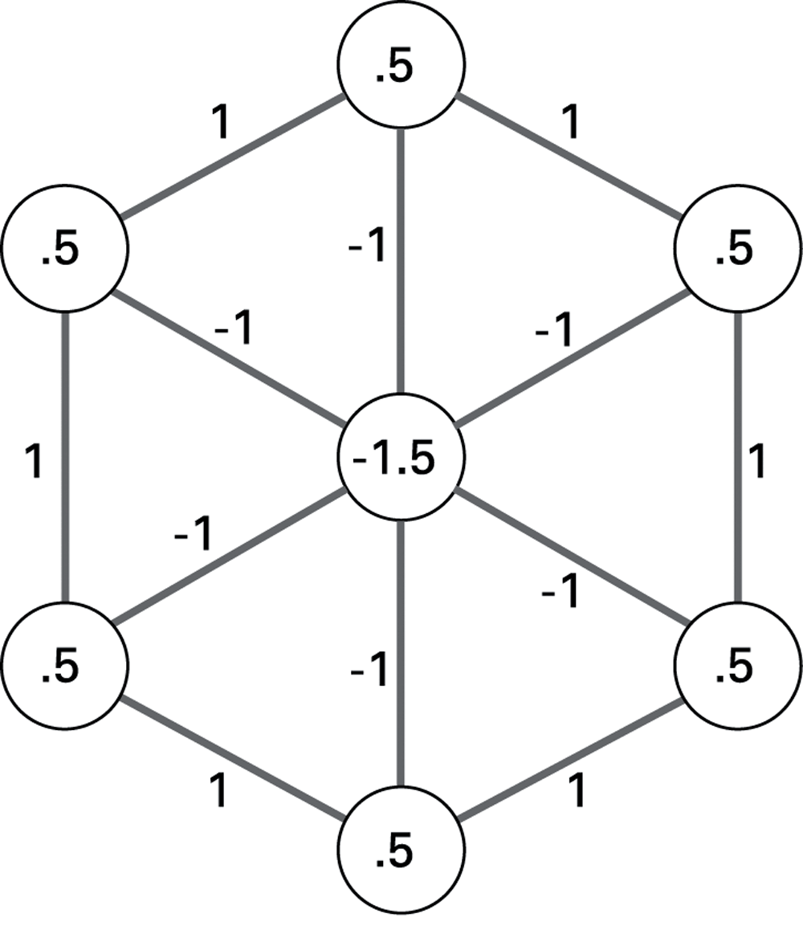
Figure 11.21 An artificial neural network implementing an associative memory
0-<number>

Slide 37
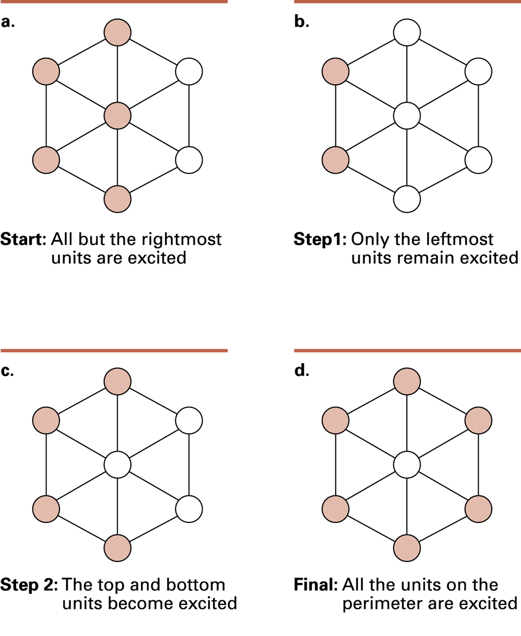
Figure 11.22 The steps leading to a stable configuration
0-<number>

Slide 38
Robotics
Truly autonomous robots require progress in perception and reasoning.
Major advances being made in mobility
Plan development versus reactive responses
Evolutionary robotics
0-<number>

Slide 39
Issues Raised by Artificial Intelligence
When should a computer’s decision be trusted over a human’s?
If a computer can do a job better than a human, when should a human do the job anyway?
What would be the social impact if computer “intelligence” surpasses that of many humans?
0-<number>

